Slide 1
Is Your Excel Production Code?
=CONCATENATE("I", " ", "Love", " ", "R")
I Love R
> paste("I", "Love", "Excel", sep =" ")
[1] "I Love Excel"
Notes:
Thank you for coming to the meetup and supporting our community here on the Eastside for the second time and the many more sessions to come in the future. Also, as you can see from the code written here the theme of today’s meetup is that as analysts and data scientists we love both Excel and R and use both as and when needed.

Slide 2

Mehar Singh
Co-Founder and CEO of ProCogia
MS in EE from Univ of Wisconsin and MBA from Univ of Washington
Have used Excel for 15 years
Have used R for 7 years
Connect with Me:
linkedin.com/in/meharpratapsingh
Twitter – @meharpsingh
Notes:
Quick back ground about myself, I am the co-founder and CEO of ProCogia and we provide data solutions consulting services. I am an engineer from my past life and did my MBA from University of Washington. I have been using Excel and R for quite some time now and have experienced the strengths and weaknesses of each of the those 2 options. My partner in crime today is, Jason and now over to Jason to talk a bit about himself, Jason?

Slide 3

Jason Grahn
I like bicycles, race cars, and cats.
One year into my Excel-to-R journey. (Fighting that Imposter Syndrome right now, hard)
13 years experience in all areas from customer support to product development.
Currently: Sr Business Analyst – Apptio
Previous: Service Analyst – Salesforce
Support Analyst – Xbox
Contact center manager – Wellcare
Notes:
Jason talks about himself and hands it back to Mehar

Slide 4
Disclaimer:
This talk represents my own views, not necessarily those of Apptio.
Notes:
Jason talks about himself and hands it back to Mehar

Slide 5
Where Excel.. Excels
Quick and dirty or single-serving analysis
Simple presentations
Simple linear regression
Simple graphs and charts
(yes, it CAN do more, but the time it takes…)
Connecting to an MSSql database
Point/click manipulation
Manipulating small amounts of data
Notes:
Thanks Jason, But before we go any further, please do a show of hands on who all here has used Excel? That was a trick question I am sure each one of you has worked on it and that one single thing is probably the most distinguishable aspect abut Excel. Its ease of use and simplicity are really appealing. But you are not here to listen about just the good stuff about it and I am going to try to play nice to Microsoft as they are one of the main sponsors for our R meetups. But looking at the next slide, it is going to be a bit tough to be nice to Microsoft

Slide 6
Problems with Excel
Reproducability
Explainability / Transparency
Limited data size
Calculation speed
Automation ability (broken VBA)
Corrupted workbooks
Dealing with date/time formatting
Version control
Differences between platforms (Mac / Win)
Sharing large analysis
Historical data
Scatterplots based on pivot tables..
Notes:
Also doing another show of hands in case you have come across at least one of the above issues. Let us take a moment to hear about what particular pain points people have experienced in the past. For me personally I have 3 major issues with Excel –
Scalability – Excel does not handle big data sets well. In theory, Excel can hold 1M+ rows and 16K+ columns of data, but in practice it slows down tremendously when using just a fraction of all those cells.
Math-ability – Excel does not offer robust statistical functionality. A simple statistical task like creating a histogram is surprisingly labor-intensive in Excel. More advanced procedures like multiple regression usually require paid add-on packages.
Clean-ability – Excel does not do well with complex or sloppy data. Sometimes your raw data is not well structured.
What we have seen with our clients is that once you get into this situation then you are ready to move on to something a bit more sophisticated. To give you an example we helped a client redo their big excel macros into programmatic tools. There are many options but there are 2 that are used predominantly – R or Python, since this is a R meetup we will be talking about R. so let us get to the next slide.

Slide 7
We are here to LEARN R
Data Manipulation
Taking any data set, no matter how messy, large or complex, and getting it to a stage that’s ready for analysis, is typically the hardest part of most analysis projects
Analysis
Doing statistical analysis mostly depends on your knowledge of statistics and plugging your data into the right functions. A robust analysis can then provide the analysts with powerful options for creating robust visualizations
Visualization
The most important component of an effective visualization is the analyst’s desire to facilitate understanding and insight by conveying the data with clarity and relevance
Notes:
Since R has a bit of a learning curve. We can basically divide it into 3 parts. First one is ingestion of data and this is where we bring in external data and clean and pre process for analysis. After analysis we need to share the output of that analysis using visualization. For today, we will be mainly focusing on the Analysis piece and basic visualization and for that I will hand it over to Jason…..

Slide 8
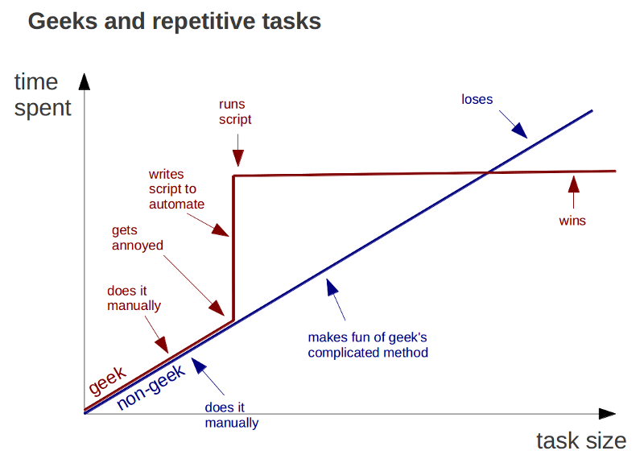
So, Why R?
Notes:
I’ll talk about my own journey. I ran along this non-geek line for a long time, I even remember telling someone ~ 8 years ago “What you’re doing in R I can do in Excel.”
I owe then an apology.
Mostly why R for me? I can automate and build a reproducible workflow.

Slide 9
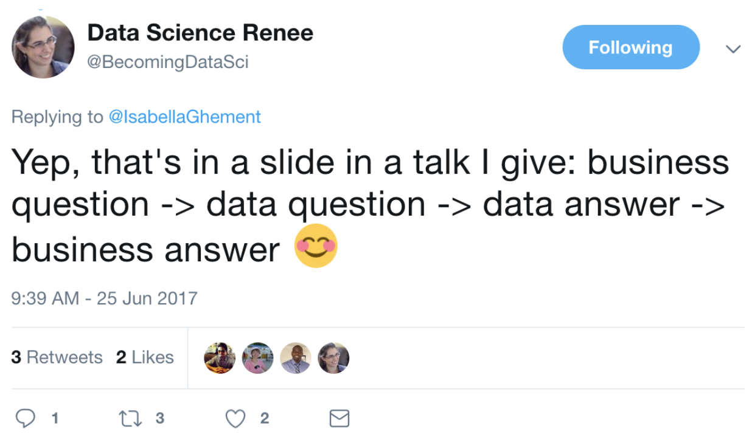
Analyst workflow
Notes:
Borrowed from twitter, I agree with the workflow. We’re going to focus on the center parts of this, data question and data answer

Slide 10
Analyst workflow (translated)
Get asked business question
Translate to data question
Figure out how to answer the question
Figure out what data is needed
Figure out where that data is
Figure out how to get that data
Analyze that data
Provide data answer
Provide business answer
Notes:
Because these are the parts where the effort sits. The assumption is we’ve all struggled with parts in excel and we’ll show some introductory level methods to get out of excel and toward automating those million dollar questions….

Slide 11
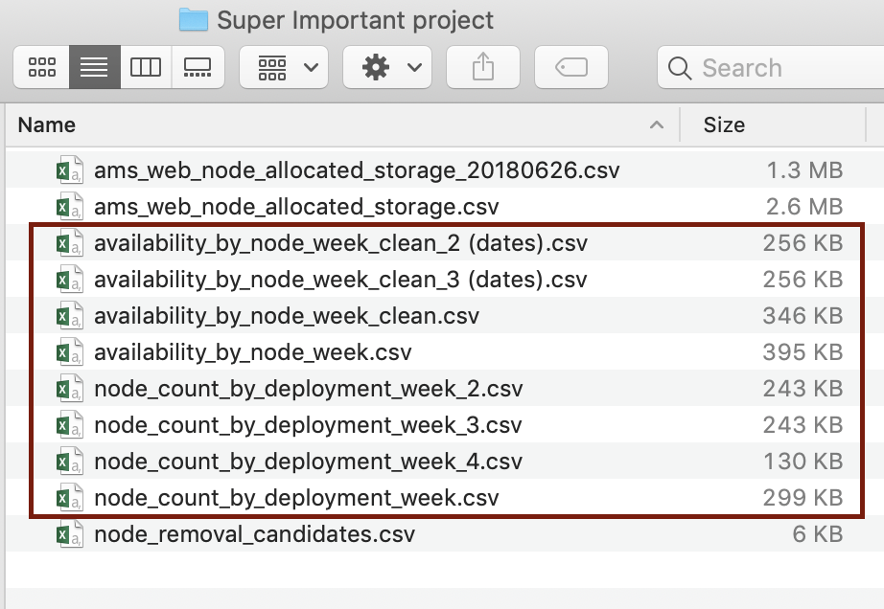
We all have that one coworker
Excel “version control”
Notes:
Which allows us to turn this coworker…

Slide 12
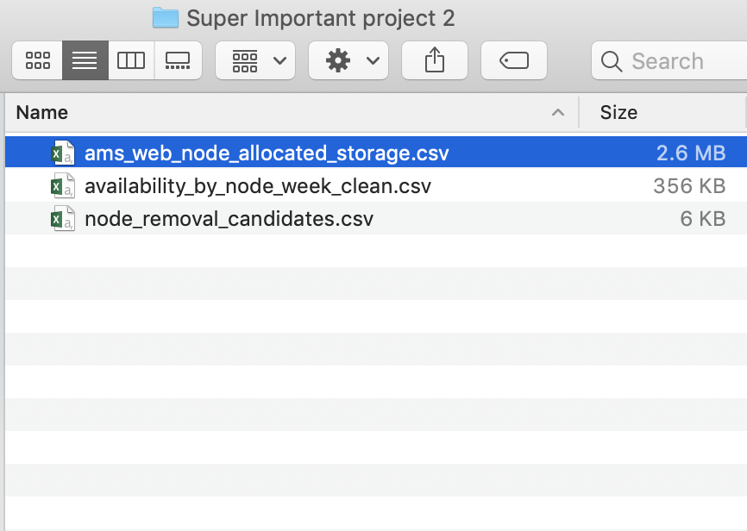
That same coworker in R
Less files in the folder because the work is done by script.
Notes:
Into the coworker that ships 1 data set and 1 r script.

Slide 13
Importing
Are you working with flat files or databases?

Slide 14
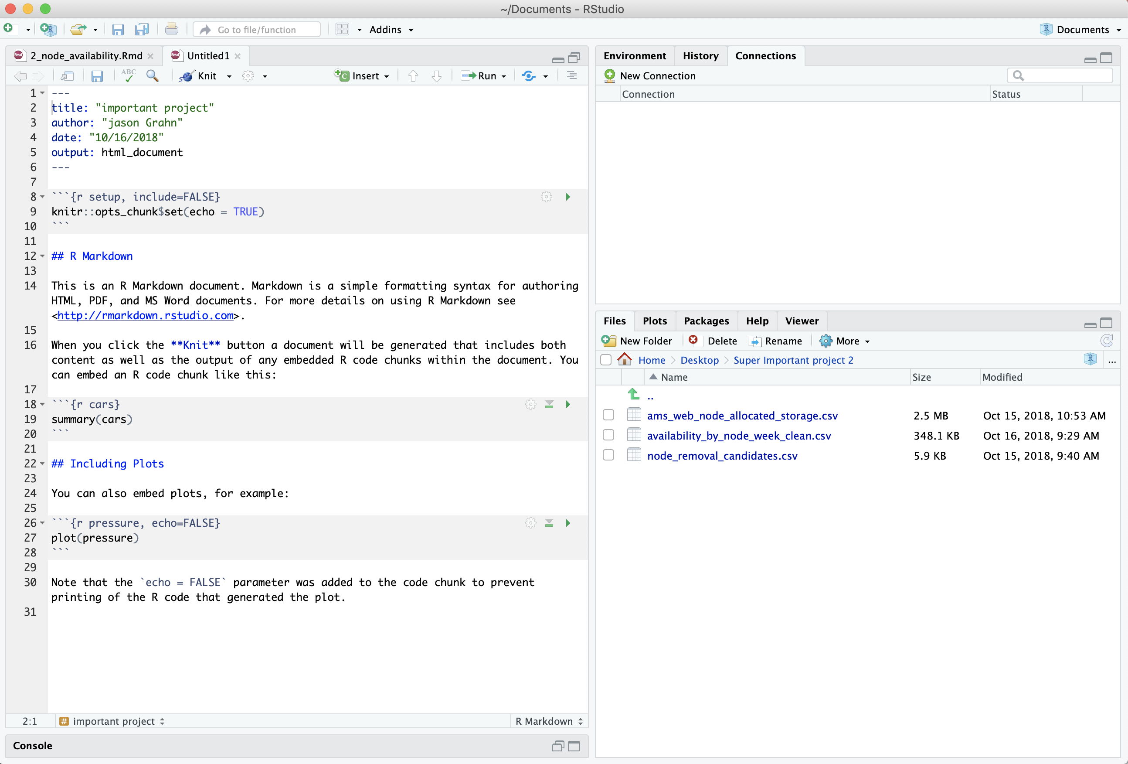
Importing a CSV (R)
Click the filename
Import Dataset
A new screen appears! ….
Notes:
The Rstudio interface. It’s the application I use (and as I said, I’m my favorite subject.)
Cool, so how do we open a CSV? Steps are similar to excel in that all we need to do is Click click import. This is great for beginners…

Slide 15
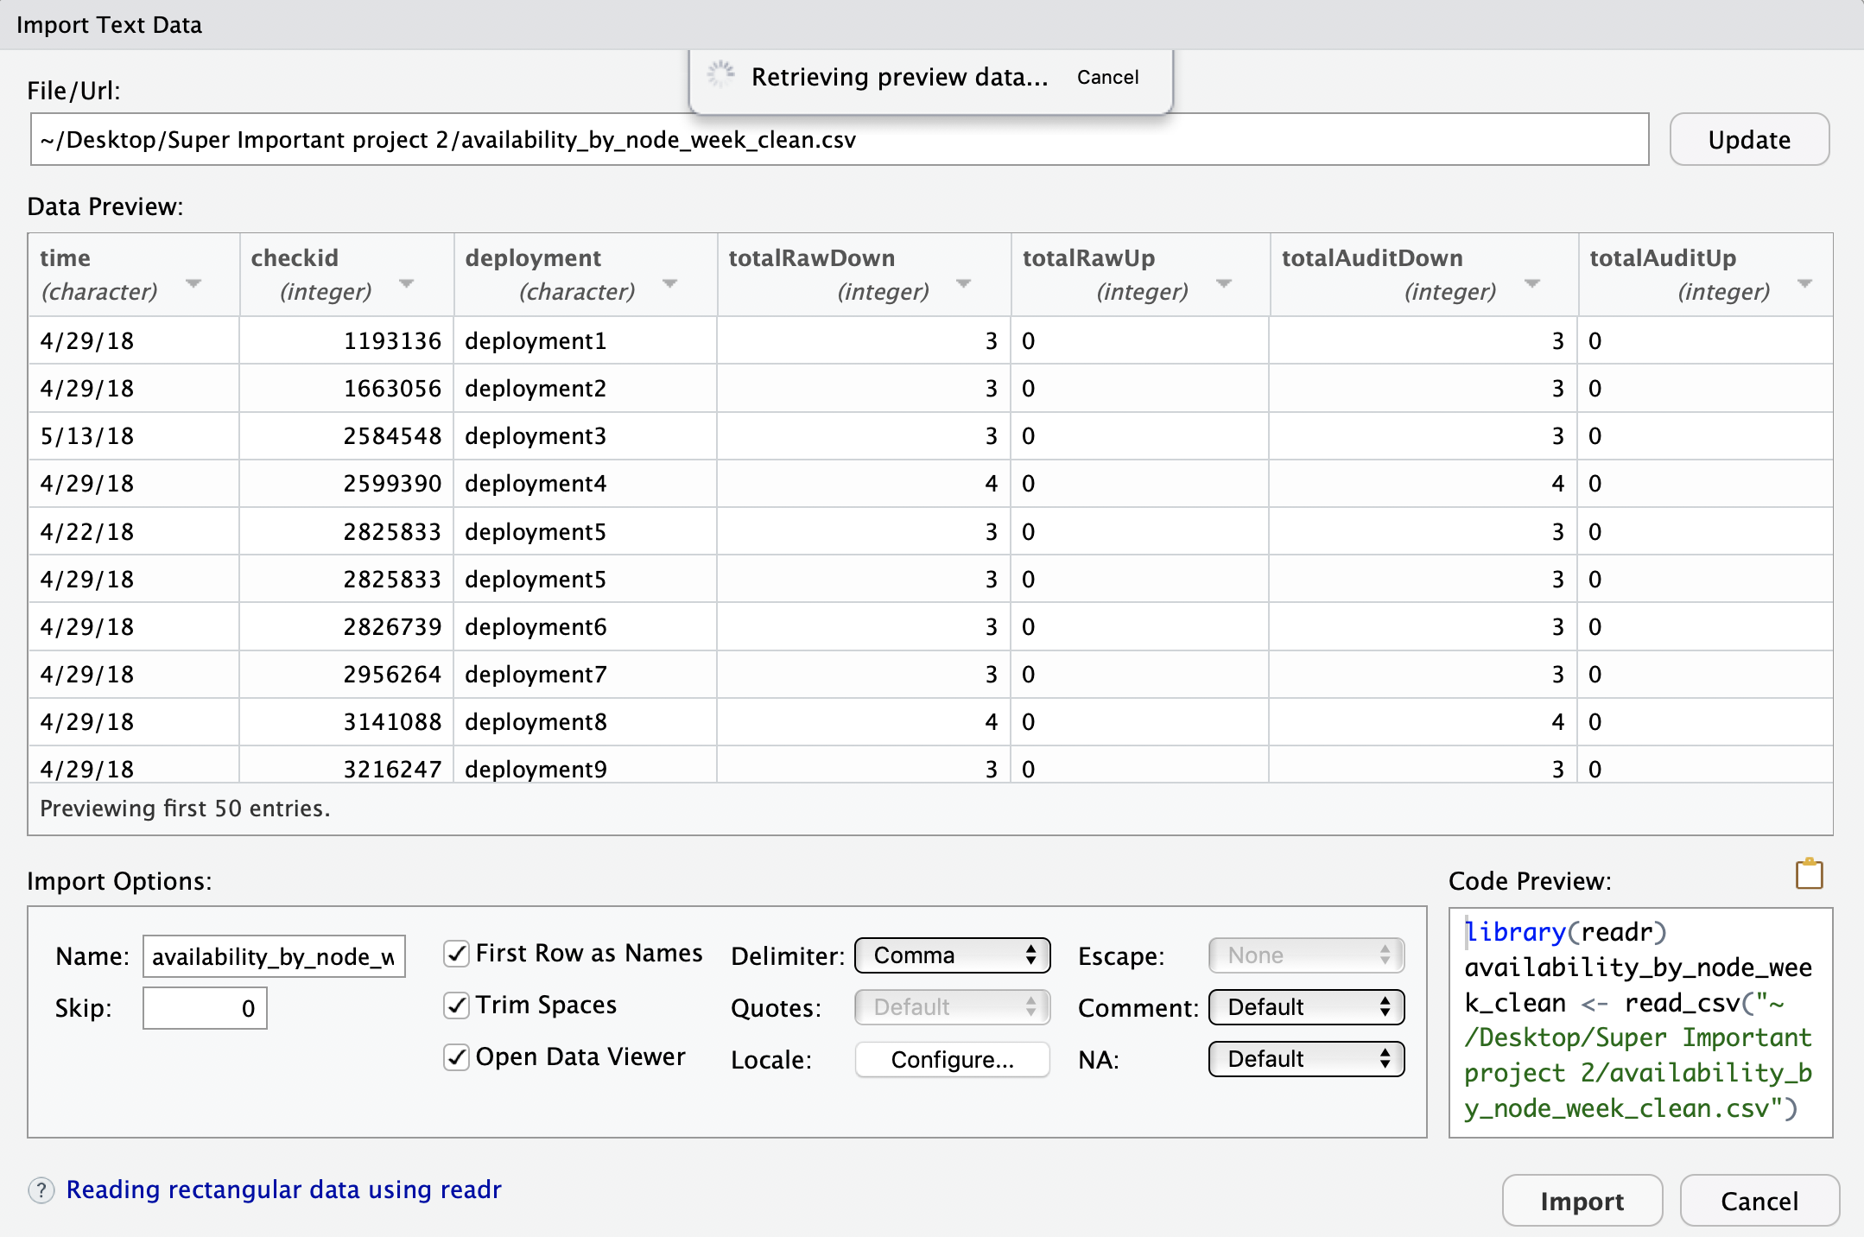
Importing a CSV (R)
Set the data types
Get a code preview
Import! ….
Notes:
And As we get more advanced, we pull the files in through code. This becomes more important as we get more advanced, and need to pull in multiple files for bigger better analysis projects.

Slide 16
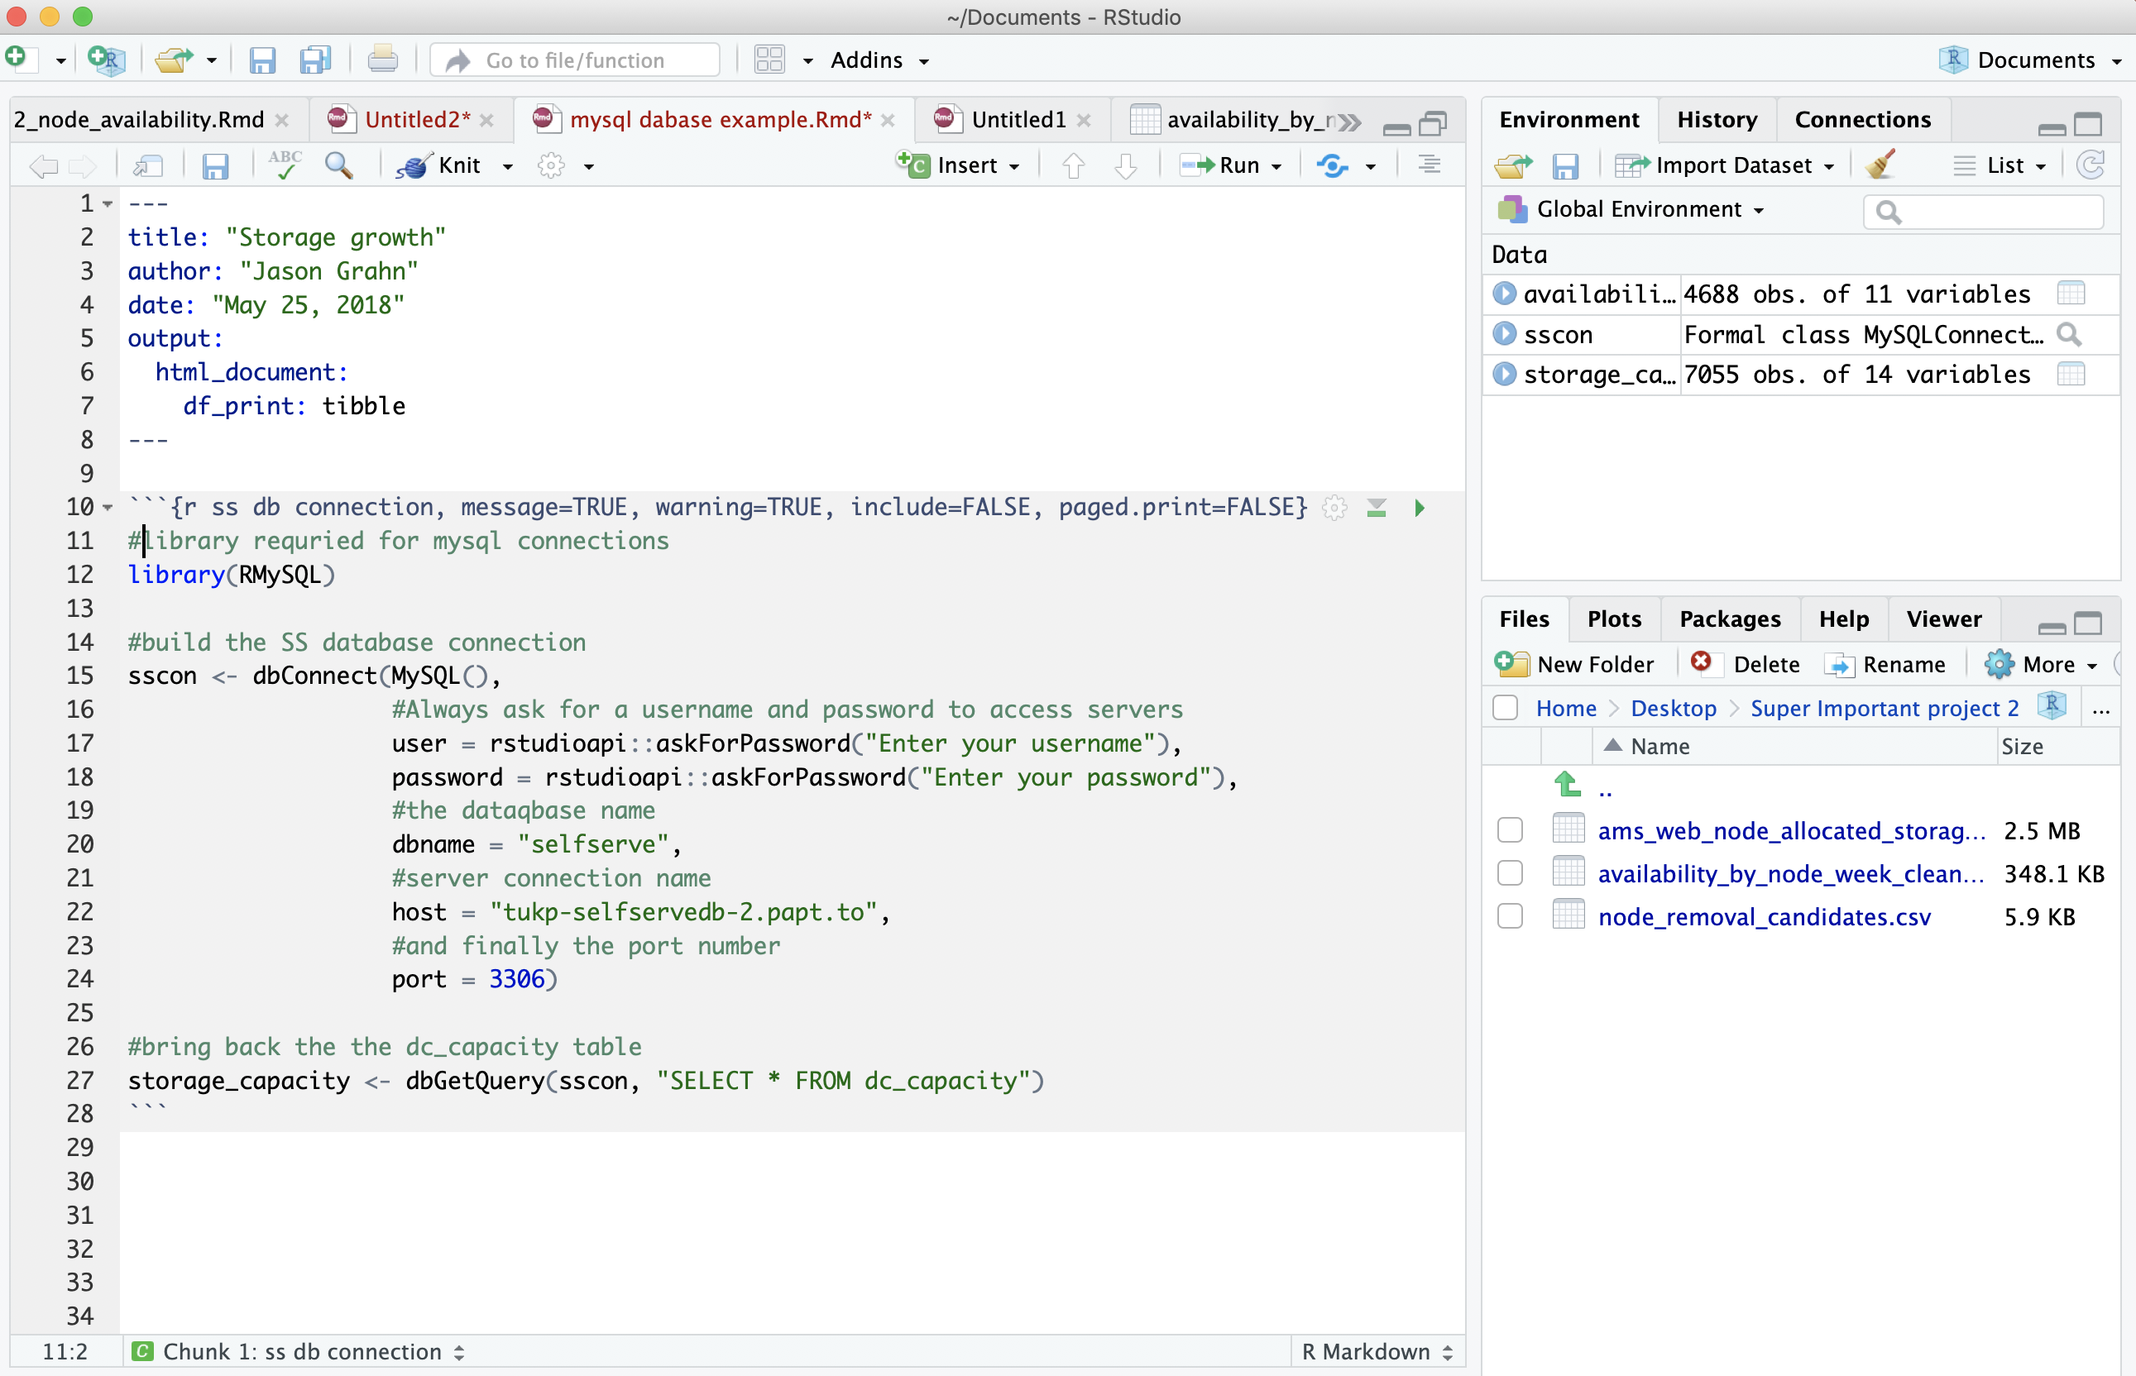
Connecting to a database (R)
Load a specific library
Configure connection elements
Force user security
From there it’s “as easy as” SQL
Output is stored into the Environment
Notes:
Working through databases follow similar steps to excel, just without a pre-built form to fill out.
Here, I’m connecting to a mysql. If I pass this script to someone else, the can execute and collect the same information I do.
Note that we can also force security but asking for UN and PW with every connection.
Here, we connect to mysql, run a sql query, and store it in memory to be used for analysis.

Slide 17
Grouping & Summarising
Those pivot table things..
Notes:
Excel gurus impress folks by the ability to pivot data. Point and click, new aggregates! Let’s do that in R with a very simple data set

Slide 18
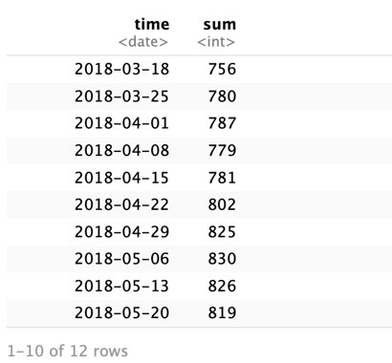
But in R?
Code
execute
```{r}
#start with the node_count data
node_count_by_deployment_week %>%
#turn "time" from <char> to <dates>
mutate(time = mdy(time) %>%
#group by time and deployment
group_by(time) %>%
#give me staging stats
summarise(sum = sum(Staging))
```
Notes:
personally, the biggest hurdle for me moving from Excel was getting used to not looking at the original dataset with each transformations happened.
Here I've oaded a dataset called “node count by deployment week”.
Contains a few hundred deployments of a thing, and how many “staging” nodes those things have.
We want to find if there’s anything odd with trends. With a few lines of code, I can add up how many staging nodes were around, making sure we can play with that "time" variable as actual dates.

Slide 19
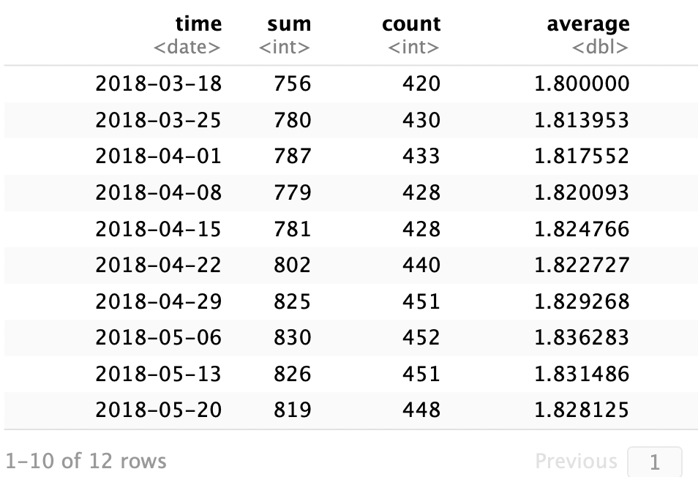
Expanding the pivot
```{r}
#start with the node_count data
node_count_by_deployment_week %>%
#turn "time" from <char> to <dates>
mutate(time = mdy(time) %>%
#group by time and deployment
group_by(time) %>%
#give me staging stats
summarise(sum = sum(Staging),
count = n(),
average = sum/count)
```
Notes:
Once we’re used to the R language as opposed to the GUI and calculated columns, If there’s a summary metric, we can call it with summarise.
Here we expanded the pivot by adding two lines, one for count and one for average.
Yes I know I took the long way to make average, it’s because I wanted to show we can math different summaries against each other too.
Remember this average because we’re going to do some bad analysis against it.

Slide 20
Filtering
Do you filter before or after the pivot?
Notes:
The real answer is "it depends"
If you filter in the data, you might removing rows/observations that can be useful later.
But when we’re handing pivot tables over to someone else, they mess with the filters and always forget how to set it back to the original.
Sometimes we need to take that power away from them.

Slide 21
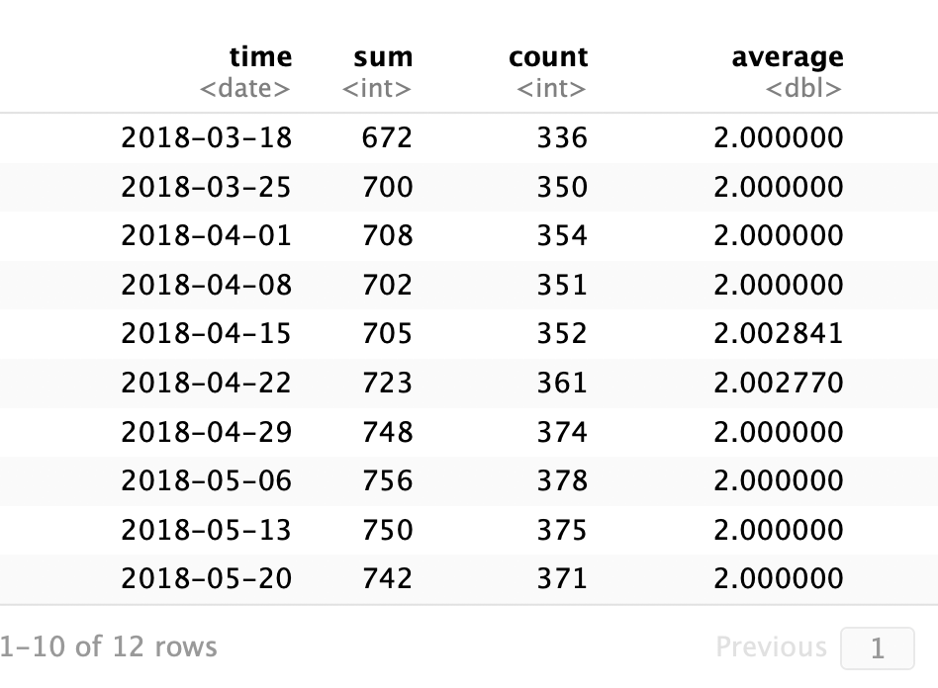
Filter before the pivot
```{r}
#start with the node_count data
node_count_by_deployment_week %>%
#turn "time" from <char> to <dates>
mutate(time = mdy(time) %>%
#only want nodes with more than 1 Staging
filter(Staging > 1) %>%
#group by time
group_by(time) %>%
#give me staging stats
summarise(sum = sum(Staging),
count = n(),
average = sum/count)
```
Notes:
Here, we threw in one line to get rid of all the deployments that had only 1 of those nodes. The average changed significantly and now we have two weeks with odd behavior

Slide 22
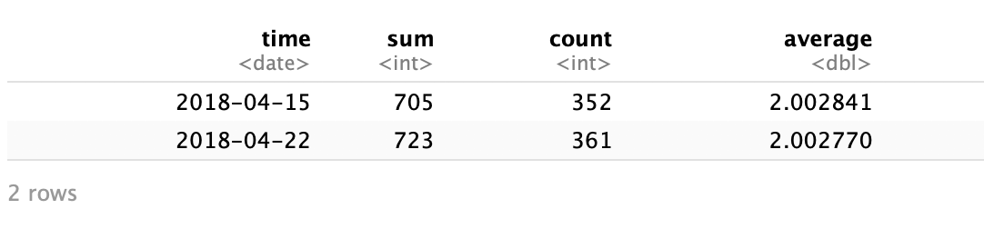
Filter after the pivot
```{r}
#start with the node_count data
node_count_by_deployment_week %>%
#turn "time" from <char> to <dates>
mutate(time = mdy(time) %>%
#only want nodes with more than 1 Staging
filter(Staging > 1) %>%
#group by time
group_by(time) %>%
#give me staging stats
summarise(sum = sum(Staging),
count = n(),
average = sum/count) %>%
#only want to see weeks where the average was >2
filter(average > 2)
```
Notes:
If someone wanted just those, we throw a filter AFTER the pivot (aggregate / summarization), to call those out.
This is to say we can filter at any step of the process.

Slide 23
Graphing
(Making pretty pictures with numbers)
Notes:
Pictures speak a thousand words and we know feeding someone a table of data is hard to read.
So we build them pictures.
But first a little trick.

Slide 24
Assigning a name to the data
Add one line of code
And we can call it later
```{r}
two_plus_nodes <-
node_count_by_deployment_week %>%
#force time into date format
mutate(time = mdy(time)) %>%
#only want deployments with more than 1 Staging
filter(Staging > 1) %>%
#group by time
group_by(time) %>%
#give me the staging stats
summarise(sum = sum(Staging),
count = n(),
average = sum/count)
```
```{r}
two_plus_nodes
```
Notes:
In the imagined scenario the business has accepted this aggregate as truth
Which means we don’t need to keep running the same long script over and over
Assign it to a data frame to save yourself from redundant code or making future typos

Slide 25
Making Graphics
```{r}
two_plus_nodes %>%
ggplot() +
geom_line(aes(x = time, y = average))
```
Notes:
We take that data, set the stage for a plot, then give it places to go.
Who remembers from previous meetup talk; what parts of this code does what? And I’m patient enough to wait for an answer.

Slide 26
Making Graphics
```{r}
two_plus_nodes %>%
ggplot() +
geom_line(aes(x = time, y = average))
```
Notes:
Right, so this works to fulfill building a graph, but we all know VPs want PRETTY graphs so lets do that.

Slide 27
Making pretty Graphics
```{r}
two_plus_nodes %>%
ggplot() +
geom_line(aes(x = time, y = average),
color = "orange") +
theme_bw() +
labs(title = "Monitoring average nodes",
subtitle = "Nodes per foo spiked during mid-April")
```
Notes:
And bam, we have something they want to look at in a presentation.
Adding a few lines of code changes the way this looks!
Can someone to call out what each of these highlighted sections does?

Slide 28
Making pretty Graphics
```{r}
two_plus_nodes %>%
ggplot() +
geom_line(aes(x = time, y = average),
color = "orange") +
theme_bw() +
labs(title = "Monitoring average nodes",
subtitle = "Nodes per foo spiked during mid-April")
```
Notes:
the color of the line to brand this in my company color
The theme to change the background palette. (there are something like 20 pre-built themes)
“labs” lets us easily add labels, subtitles, and captions.

Slide 29
Additional resources
Other EXCEL things that you can do in R:
VLOOKUP using Merge or Join function in R
Macros versus R Scripts
Additional resources:
https://trendct.org/2015/06/12/r-for-beginners-how-to-transition-from-excel-to-r/
https://www.rforexcelusers.com/
Book – R for Excel Users by John L. Taveras
Self-paced training
R 4 Data Science free textbook: http://r4ds.had.co.nz/
R 4 DS slack community: https://www.jessemaegan.com/post/join-the-r-for-data-science-online-learning-community/
Other misc R stuff
Configuring ODBC conncetors for R on a Mac: https://db.rstudio.com/best-practices/drivers/
Notes:
Here are a few resources to get folks on their journey, I particularly like the R4DS book and community.

Slide 30
Thank you!
Eat the pizza.
Notes:
I will be handing over to DAA so that she can talk about DAA Seattle Symposium

Slide 31
DAA SEATTLE SYMPOSIUM

Slide 32
DAA Mission
Advancing the use of data to understand & improve the digital world through professional development and community
www.digitalanalyticsassociation.org

Slide 33

Location: Microsoft Conference Center
Redmond, WA
Notes:
Speakers include: Zack Mazzoncini – Data Story

Slide 34
Program Highlights
Fantastic speaker lineup!
Tyler Guttman, Nordstrom – Multi Touch Attribution
Zack Mazzoncini, Data Story Academy – Data Storytelling
Madelyn Mills, Providence St. Joseph -
Interactive Roundtables including one by ProCogia
Networking Reception
New feature: Analytics Improv!

Slide 35
SEA18_PROCGRP
SEA18_PROCGRP
PROCGRP
http://bit.ly/DAASeattleuseRGroupSeattle
Use code SEA18_PROCGRP for a 20% Discount
Register by this Thursday, October 25 to stack with early bird discount!

